Slide 1
Reminder App
Haihua Huang
Yuxin Zhang
12/05/2018

Slide 2
Problem Statement
Nowadays, it is important to make everything on schedule especially for students.
Save time
Avoid big loss

Slide 3
Project Objective
Allow people to add tasks
Allow people to edit tasks
Allow people to view tasks
Remind users to finish their tasks

Slide 4
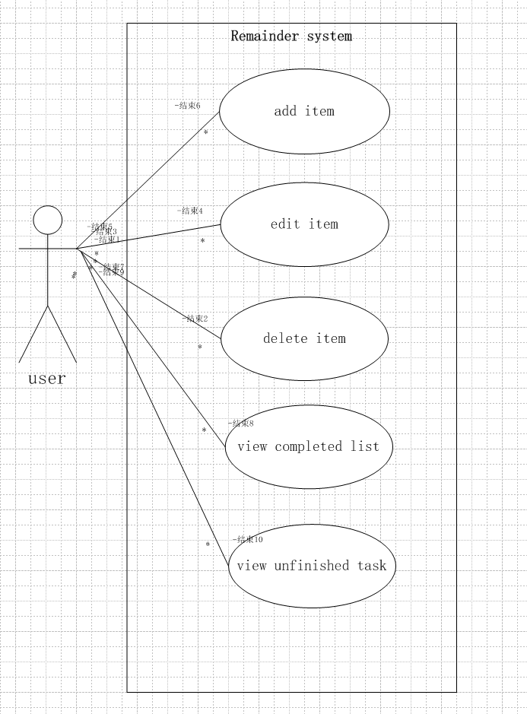
Use Case Diagram

Slide 5
Add Item
Use case: add item
Actors: users
Goal: to add to do things in the to do list
Overview: User open the app, choose to the add the events, enter the to do things in the textbox, then choose the date, month, year and time to remind. This event and deadline will be added and showed in the list.
Type course of events Actor Action: 1.users open this app 3.users choose to add items 5.users enters the thing’s name 6.users choose the remind time 7.users confirm adding this to the list | System response: 2.show the to do list 4.turn to another page to add the item 8.add this item to the list and show the to do list
Alternative courses: Step 5-8: if there has the same item (same events name & same remind time) in the list, system alerts that the item is already on the list, please insert the different event name or choose a different remind time.

Slide 6
Edit Item
Use case: edit item
Actors: users
Goal: to edit the events already in the to do list
Overview: User see the to do list, they want to modify the specific item, they can modify the name and time of reminder events. Or they have done this event, they can click the checkbox means this event have be done.
Type course of events Actor Action: 1.users open this app 3.users click the specific item 5.users enters the event’s name 6.users choose the remind time 7.users confirm editing this to the list 9.users click the checkbox | System response: 2.show the to do list 4.turn to another page to edit the item 8.update this item to the list and show the to do list 10.delete this item from the to do list and add this item to the completed item.
Alternative courses: Step 5-8: if there has the same item (same events name & same remind time) in the list, system alerts that the item is already on the list, please insert the different event name or choose a different remind time.

Slide 7
Delete Item
Use case: delete item
Actors: users
Goal: to delete the events already in the to do list
Overview: User see the to do list, they want to delete the specific item, they can delete it from the to do list.
Type course of events Actor Action: 1.users open this app 3.users click the specific delete icon 5.users click ‘yes’ | System response: 2.show the to do list 4.pop up a small window (Are you sure to delete this item?) 6.delete this item from to do list 7.update the to do list and show the to do list
Alternative courses: Step 4-7: users do not want to delete this item, this click ‘NO’, and then this item will not be deleted, and shows the to do list to user again.

Slide 8
View completed List
Use case: view completed list
Actors: users
Goal: to view the things they have done
Overview: User want to see what they have done in this week, this month, even this year. They can see the chronological order of the events they have completed in the completed list.
Type course of events Actor Action: 1.users open this app 2.users click the ‘completed list’ | System response: 3.turn to another page 4.show the completed list

Slide 9
View Unfinished List
Use case: view unfinished list
Actors: users
Goal: to view the things after the set time but have not done
Overview: User want to see what they forget to do before the set time. They can see the list of the forget events they have not completed in the uncompleted list.
Type course of events Actor Action: 1.users open this app 2.users click the ‘uncompleted list’ | System response: 3.turn to another page 4.show the uncompleted list

Slide 10
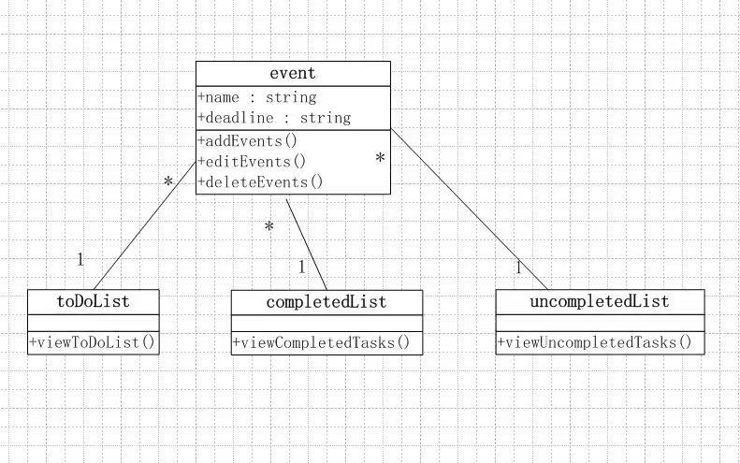
Class Diagram

Slide 11
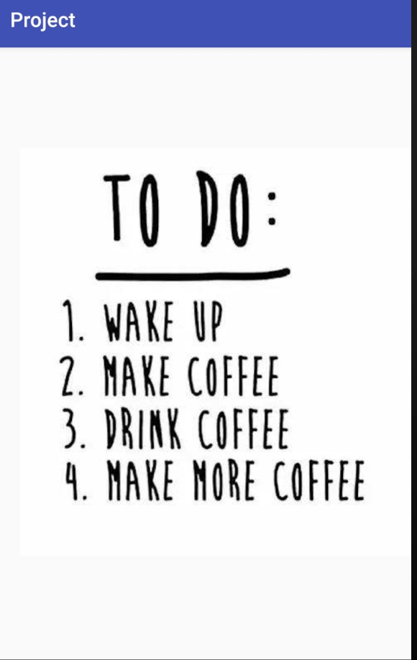
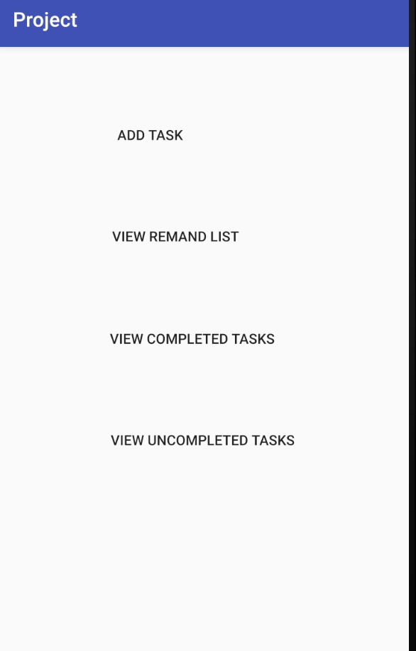
Simple view of the app
Opening version
Typical version

Slide 12
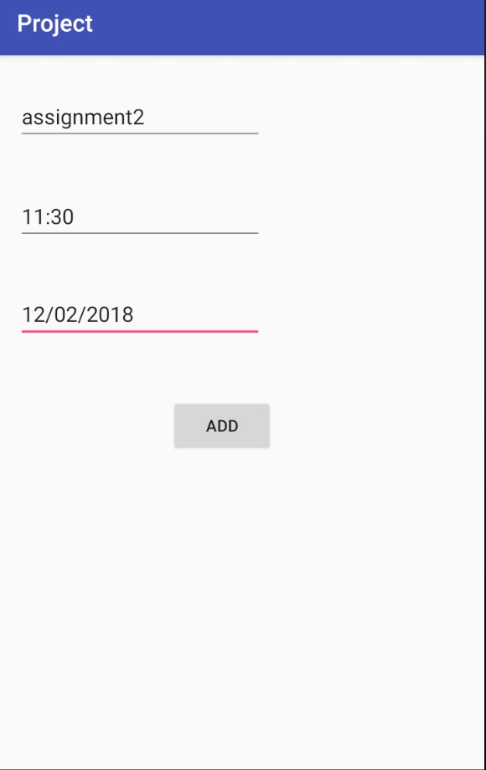
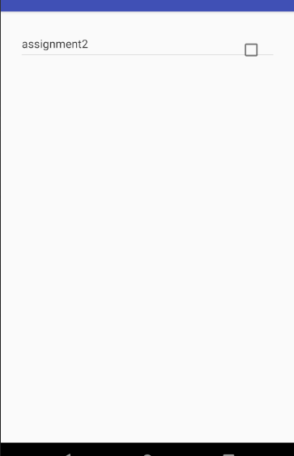
Add new item
View the to do list

Slide 13
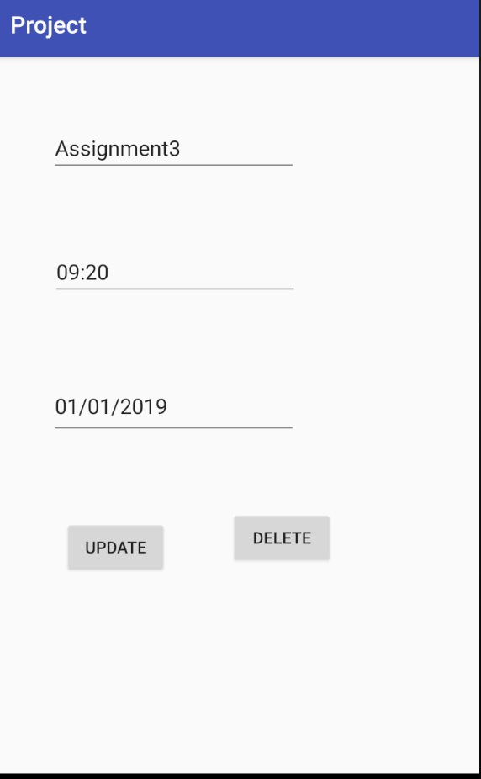
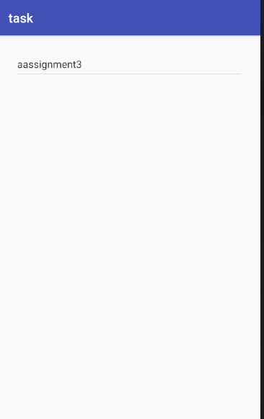
Edit or delete the item
View the completed list

Slide 14
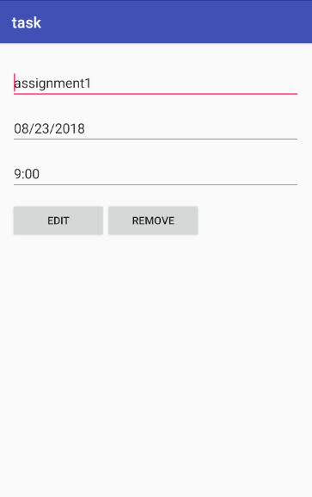
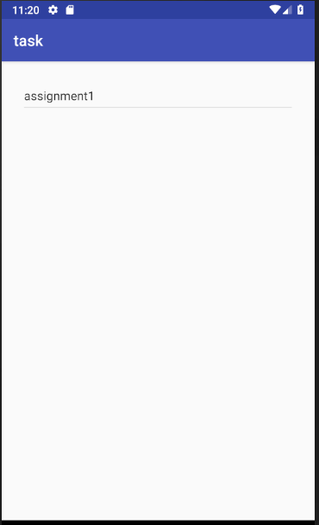
View the unfinished list

Slide 15
Thank you

